Slide 1
CostPilot Agent
HACKATHON PROJECT
An AI agent that finds AWS cost savings, safely
EC2
EBS
RDS
MSK
S3
Notes:
Welcome. CostPilot Agent looks inside an AWS account and shows where you are overspending, without changing anything. It covers EC2, EBS, RDS, MSK and S3.

Slide 2



Cloud waste hides in plain sight
Idle and oversized
Spread everywhere
Slow to review
Forgotten disks, stopped servers and over-provisioned databases.
Many regions and many accounts, each with its own bill.
Checking by hand takes days, so it rarely gets done.
CostPilot Agent · read-only · evidence-based
Notes:
Cloud bills grow quietly. The waste is spread across regions and accounts, and reviewing it by hand takes days, so it usually does not happen.

Slide 3

How it works
Claude decides what to check. The tools only read.
You
Claude agent
14 tools
boto3
AWS APIs
Web UI or CLI
Claude Agent SDK
Read-only, via MCP
Python AWS SDK
Read-only calls
Credentials stay on your machine. Claude only sees tool results.
Built with
Claude Agent SDK
MCP
boto3
FastAPI
CostPilot Agent · read-only · evidence-based
Notes:
You give it an AWS profile. Claude, running through the Claude Agent SDK, decides what to check and calls 14 read-only tools. The tools use boto3 to read cost, metrics and configuration for EC2, EBS, RDS, MSK and S3. Credentials never reach the model.

Slide 4
Evidence and safety
30-day rule
Safe by design
Idle only after 30 days of real metrics
Newer resources: “Needs more data”
Never counted as savings
One-off findings need owner review
Read-only AWS APIs only
Credentials never reach the model
Claude’s shell and file tools are off
Profile and regions fixed per run
CostPilot Agent · read-only · evidence-based
Notes:
A resource is only called idle or oversized if it has at least 30 days of real metrics. Anything newer is listed as needing more data and is never counted as savings. The agent is read-only by design: it calls only describe, list and get APIs, and Claude's own shell and file tools are disabled.

Slide 5
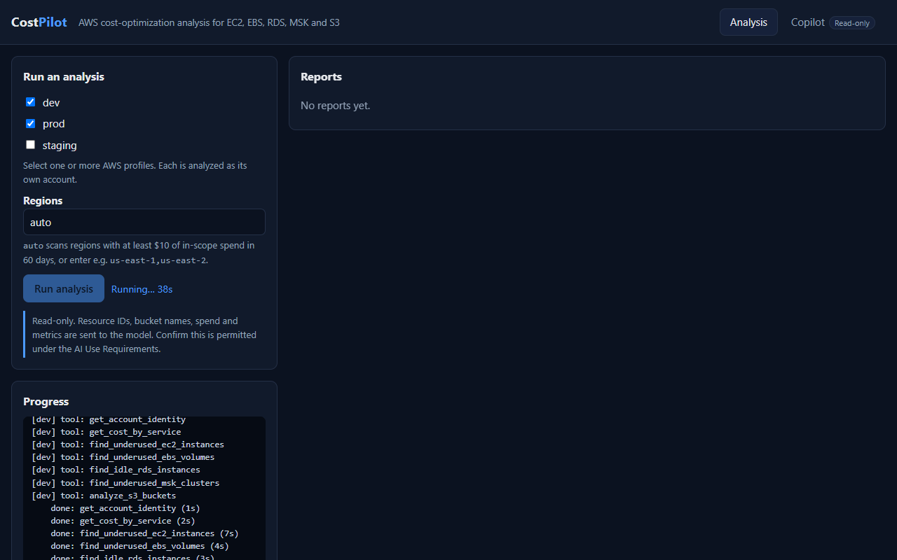
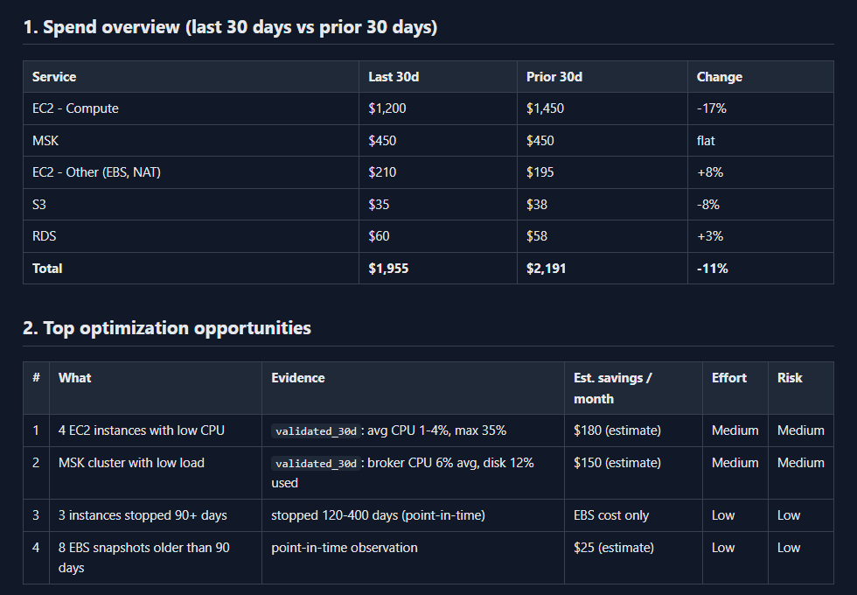
Web UI and reports
Pick accounts and watch live progress
A clean report for every account
CostPilot Agent · screenshots use sample data
Notes:
The web UI lets you pick one or many AWS profiles, scans regions automatically from spend, and shows live progress. Each account gets its own HTML report with a spend overview, ranked opportunities with evidence, quick wins, and what still needs more data. The screenshots here use sample data, not a real account.

Slide 6
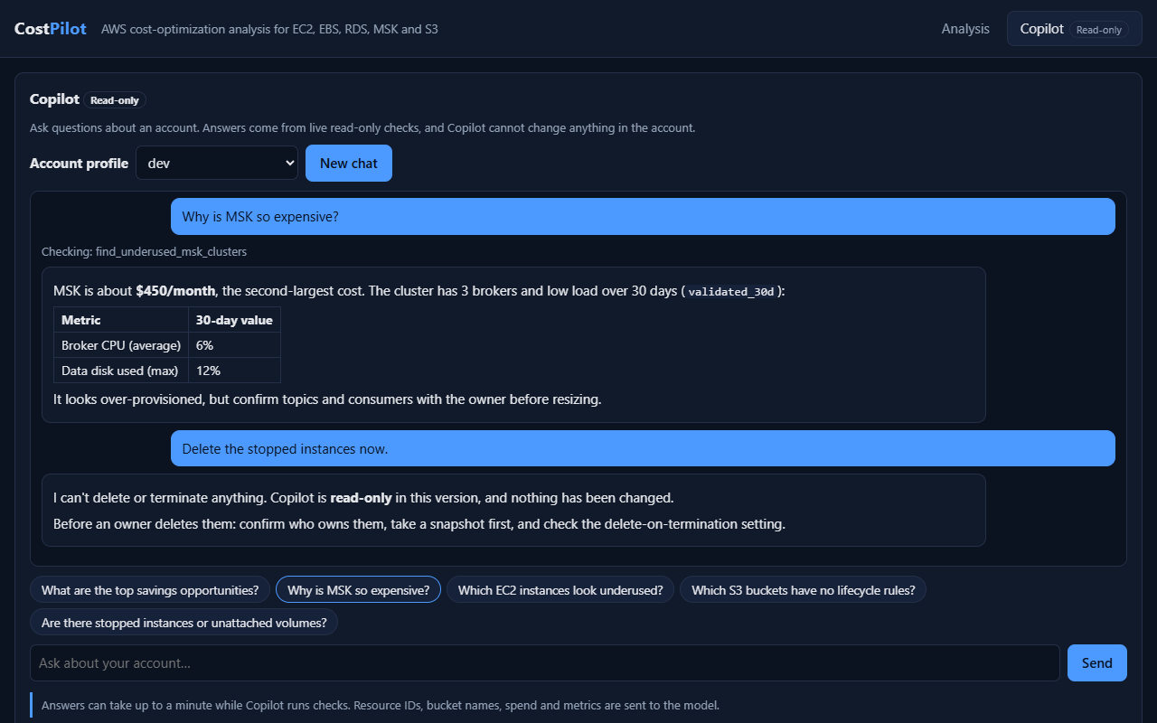
Copilot: a read-only chat
Today
Answers from live checks. It has no write tools at all.
Future
Write-enabled Copilot: one click to approve and apply the fix.
CostPilot Agent · screenshot uses sample data
Notes:
Copilot is a read-only chat about one account. Ask why Kafka is so expensive and it runs live checks and answers with evidence. Ask it to delete something and it refuses and explains what to check first. In future we are thinking of making Copilot write-enabled, so that with a single click, with the user's approval, it can do the necessary job.

Slide 7
Outcomes and roadmap
Outcomes
Roadmap
Days of manual review become minutes
Every finding backed by evidence
A safe base for governance across many accounts
A Jira ticket for each finding
Write-enabled Copilot: one click, with approval
Azure and other cloud tenants
CostPilot Agent · read-only · evidence-based
Notes:
Outcomes today: days of manual review become minutes, every finding comes with evidence, and it is a safe base for cost governance across many accounts. Roadmap, not built yet: Jira tickets for each finding, a write-enabled Copilot with one-click approved fixes, and support for Azure and other cloud tenants. The agent loop, the report and UI layers and the 30-day rule are not AWS-specific; only the tool layer would need an Azure equivalent.

Slide 8
Find the waste. Prove it. Fix it safely.
Thank you
Notes:
Find the waste, prove it with evidence, and fix it safely. Thank you.

